Slide 1
Analytics Anonymous Final Presentation
Scott Bagley, Austin Bertrand, Robert Mitchell, Dan Plumeri

Slide 2
Agenda
Recoding and Cleaning
Disease
Labor
Social Security
Modeling
Labor Force Modeling
Disease Case Modeling
Results
Social Security Analysis
Process
Results
Social Security Scenario

Slide 3
Disease Recoding/Cleaning

Slide 4
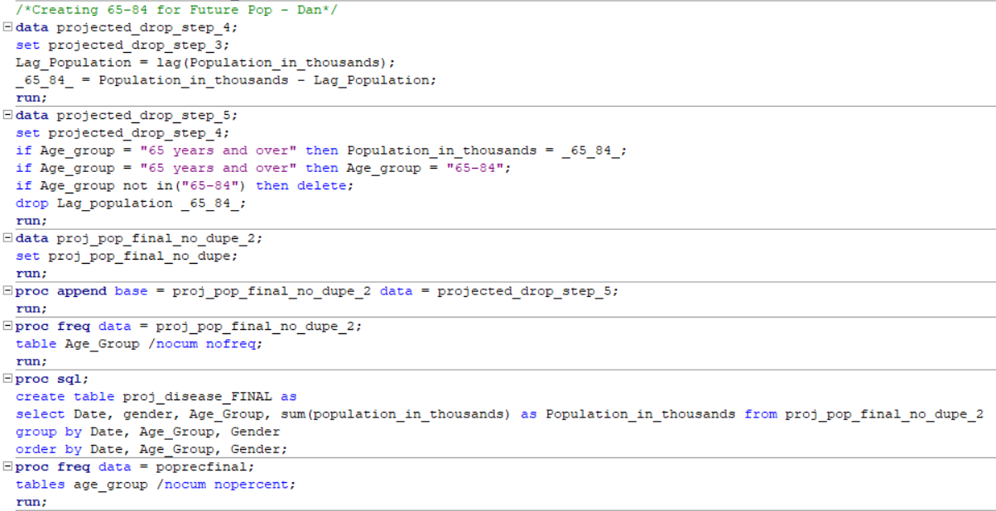
Disease Recoding
Age Buckets
0 - 17
18 - 24
25 - 44
45 - 64
65 - 84
85+
Reasoning
Stages of life
Milestones of health
Using the Lag function
Projected 65 & over, 85 & over

Slide 5
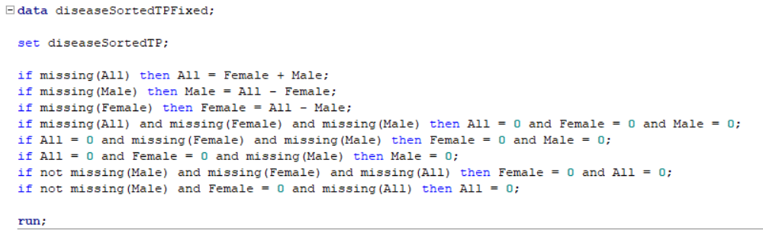
Disease Cleaning/Scoring File
Transposing the Disease Cases
Using IFs
Calculating missing values
Cleaning Data
Dropping All and both gender
Joining
Using Enterprise Guide
Export to SAS 9.4
Creating the Scoring File
Disease List Table
Proc SQL Distinct
Cross Join with Future Population

Slide 6
Labor Recoding/Cleaning

Slide 7
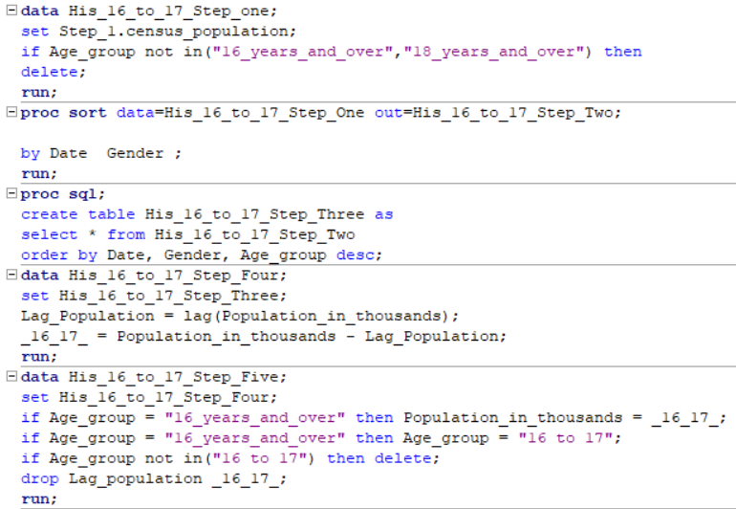
Labor Recoding
Age Buckets
16-24
25-44
45-64
65+
Lag Function
16 years and over | 18 years and over
16 - 17 for 16-24 in Projected Population

Slide 8
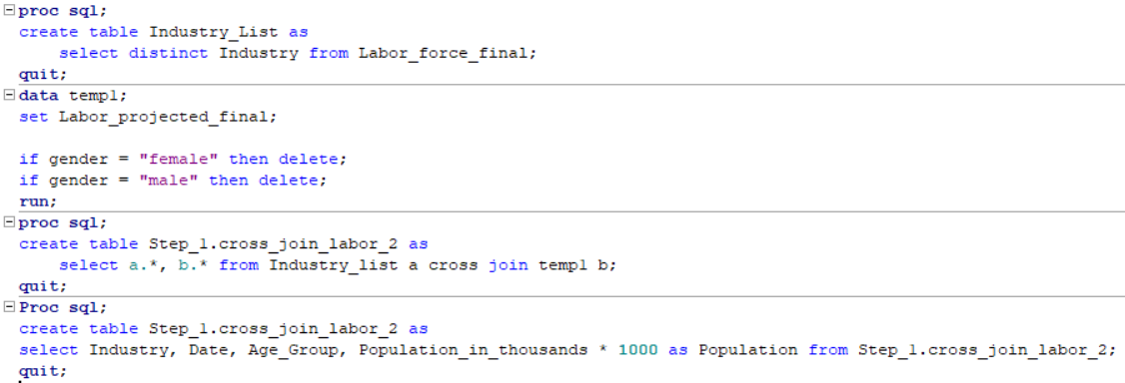
Labor Cleaning/Scoring File
Cleaning
Dropping Male and Female Genders
Ensuring numbers were in the same format
Ensuring variable formatting for joins
Joining
Using Enterprise Guide
Export to SAS 9.4
Scoring File
Industry List
Cross join with future population

Slide 9
Social Security Recoding/Cleaning

Slide 10
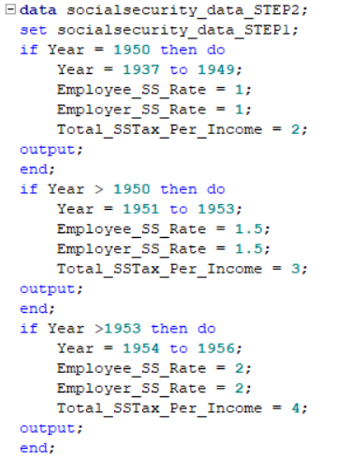
Social Security
Wage Limits
Imported into SAS 9.4 through SAS Guide
Contributions
Grouped years
I.e 1973-1975
DO Loops
Joining with occupation and pay

Slide 11
Labor Force Modeling

Slide 12
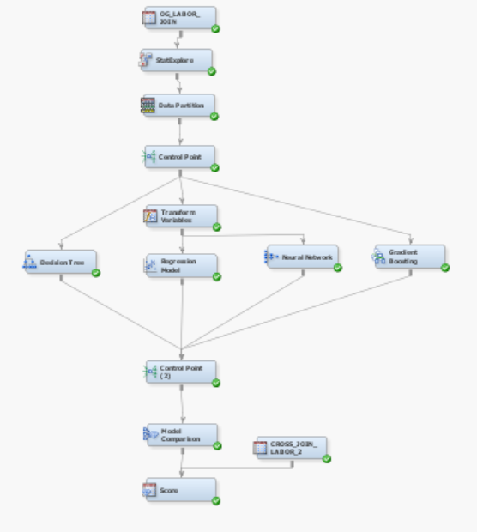
Summary of Modeling Process
Dropped
Date
Gender
Target variable
Labor Force Population
Skewed variables
Population
Labor force population
Interaction term
Age_Group*Industry
Champion model:
Linear Regression

Slide 13
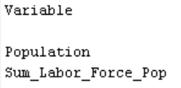
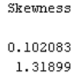
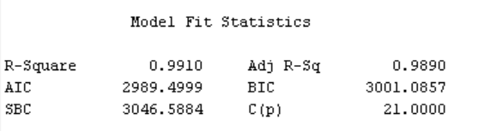
Linear Regression Model
Skewed variables
No transformation
Model continued to be overfit
Selection Method: None

Slide 14
Labor Force General Results

Slide 15
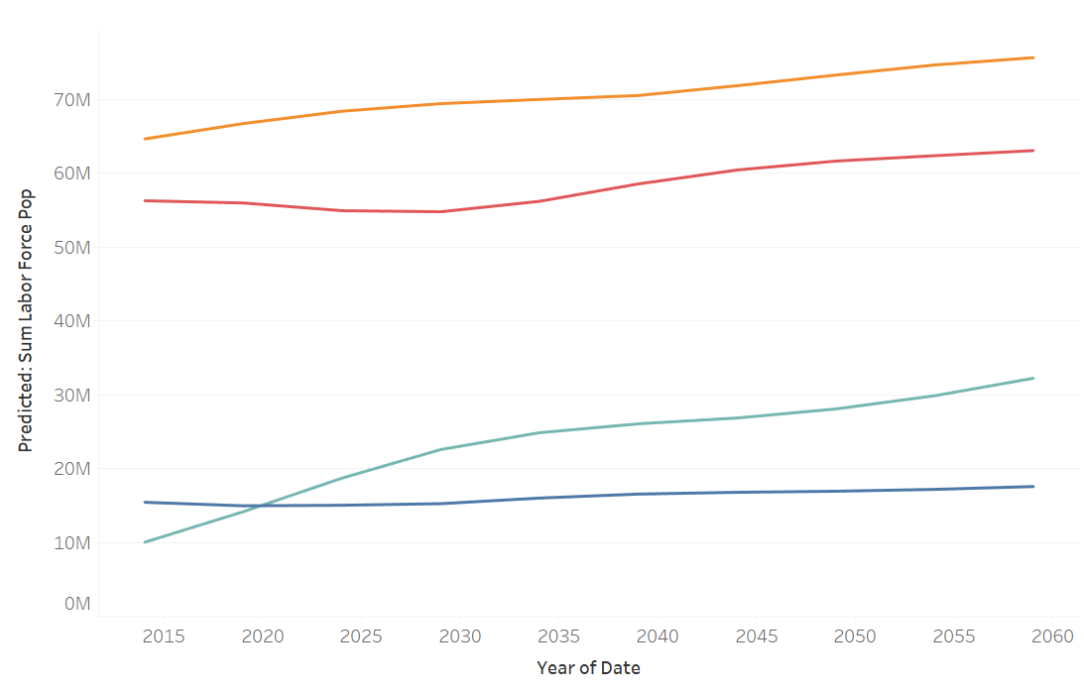
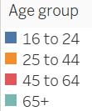
Labor Force Predicted Data

Slide 16
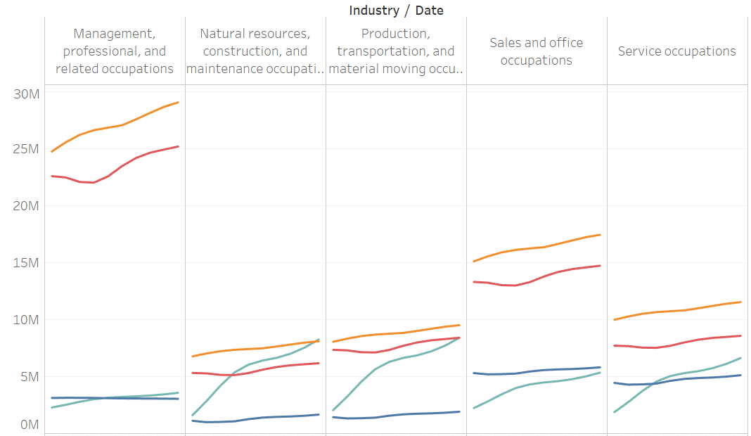
Predicted Population Industry/Age Group

Slide 17
Disease Case Modeling

Slide 18
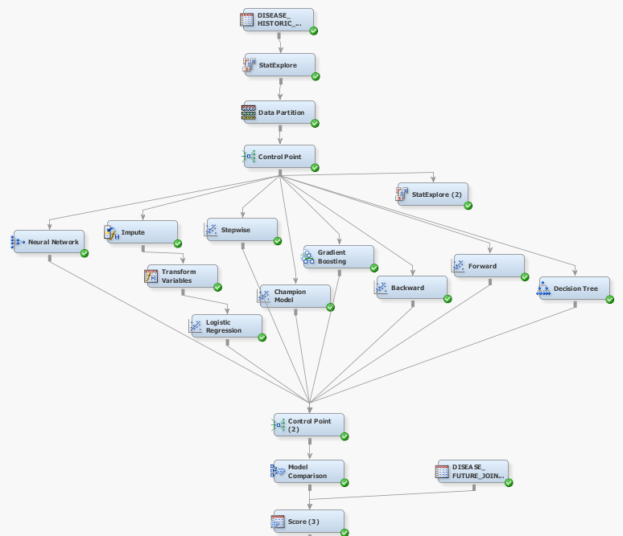
Summary of Modeling Process
Rejected Variable
Date
Target variable
Cases_In_Thousands
Transformation
Log and Log 10
Overfitting issue
Data Partition
70% validation
30% test
Scoring data set
Model future disease cases

Slide 19
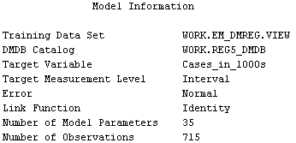

Champion Model
Model Decision
Decision tree determined best model
Neural Network complexity
Gradient Boosting
Linear Regression
No selection model used
No transformation done
Two factor interactions
Issues
Repeating variables
Negative Values

Slide 20
Disease Case General Results

Slide 21
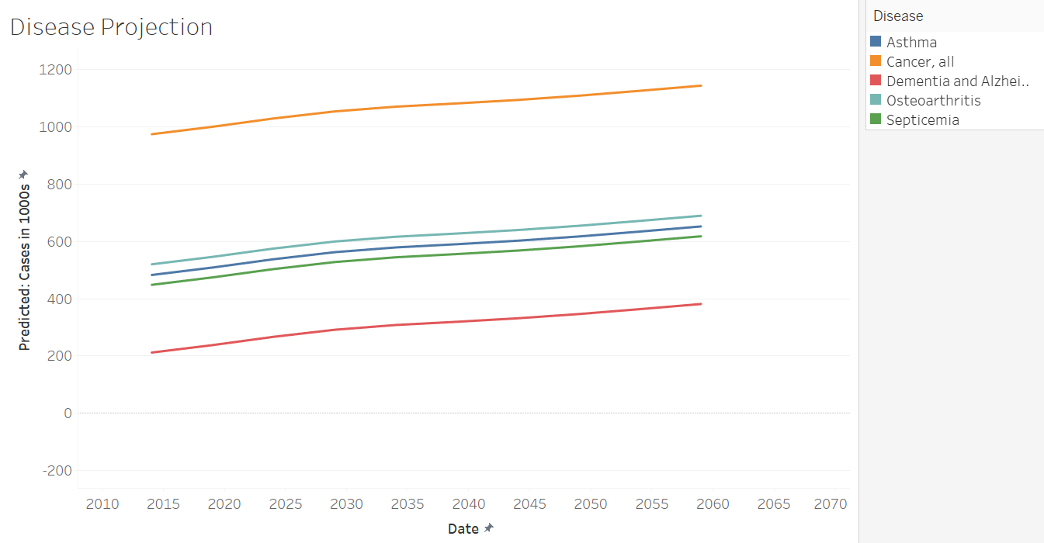
Disease Projection

Slide 22
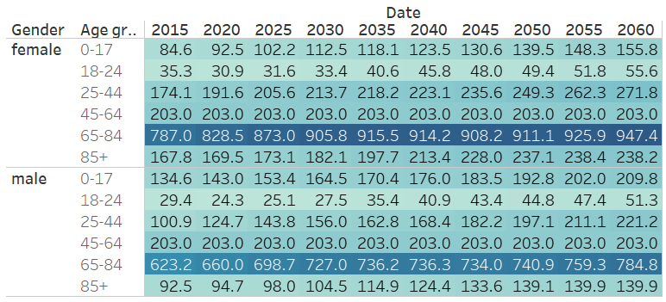
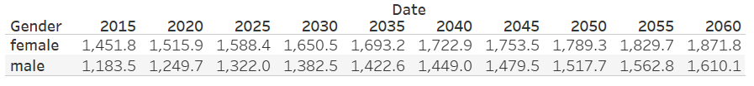
Disease Cases by Gender

Slide 23
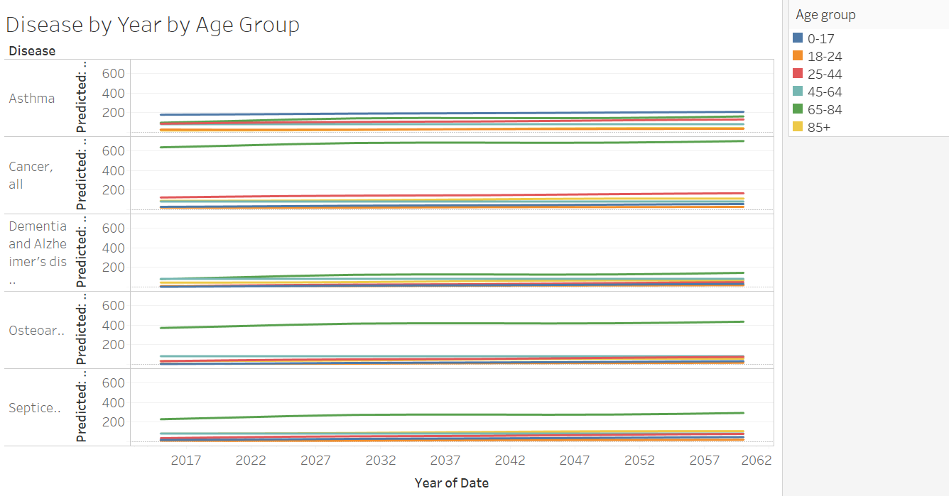
Disease By Year by Age Group

Slide 24
Social Security 2010 - 2013

Slide 25
Preparation
Completing historic labor force table to include Year, Age_Group, Industry, Labor_Force_Population, and Population
Running loop to create unique year rows corresponding with employee/employer social security rates
Joining historic labor force table with occupation and pay, social security rates, and wage limit.

Slide 26
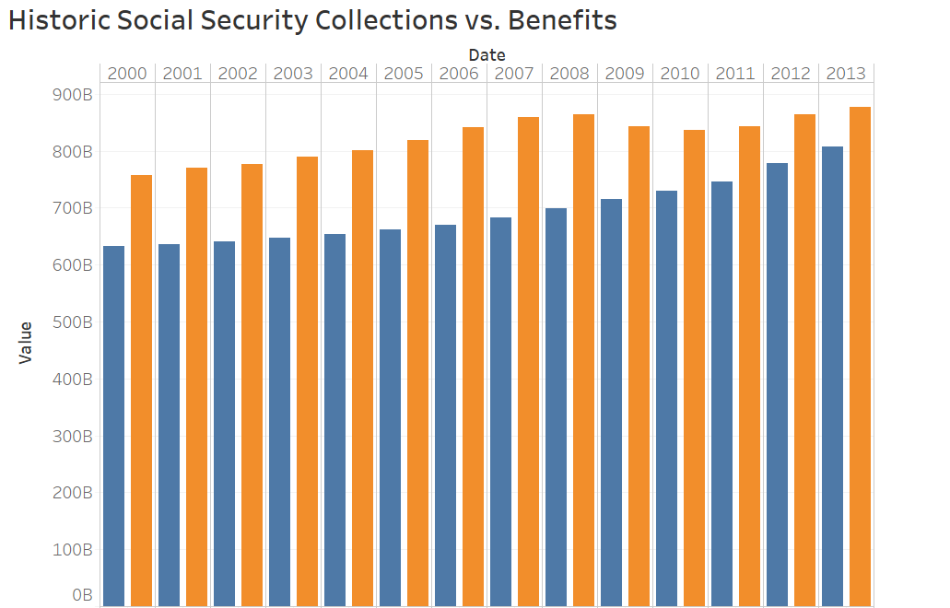

Benefits = (Population over 65 * mean monthly benefit * 12)
Collections = (Total Contributors * Total SS Contribution) summed by year
Total Contributors = (Percent Employed * Labor Force Population)
Total SS Contribution =
(Combined SS Rate * Annual Mean Wage) IF (Annual Mean Wage < Wage Limit) ELSE
Total SS Contribution = (Combined SS Rate * Wage Limit)
Combined SS Rate = (Employee + Employer Rate)

Slide 27
Social Security 2015 - 2060

Slide 28
Preparation
Completing scored projected labor force table to include Year, Age_Group, Industry, Labor_Force_Population, and Population
Running loop to create unique year columns corresponding with employee/employer social security rates
Joining scored projected labor force table with occupation and pay, social security rates, and wage limit.

Slide 29
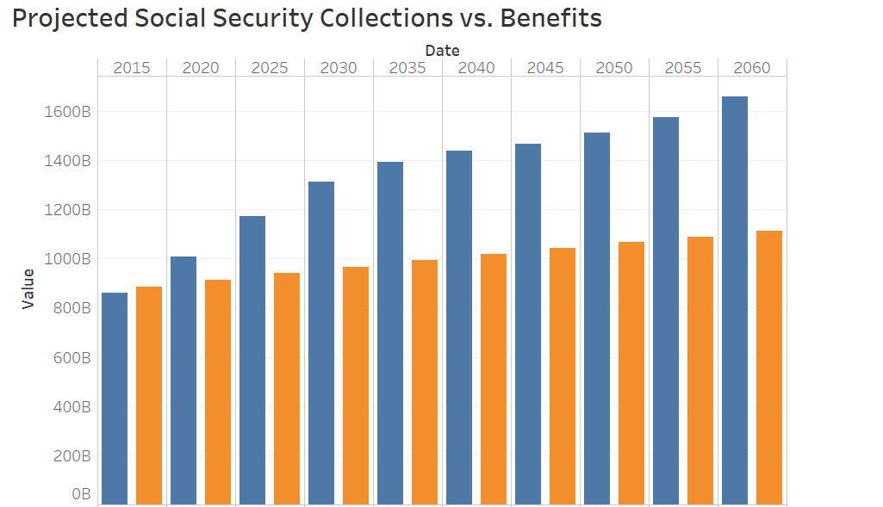
Identical computations used as in historic example instead with scored table
Benefits surpass Collections in 2020
Benefits/Collections Disparity nears 500B by 2060

Slide 30
Social Security Scenarios

Slide 31
Scenarios
Raising Employer/Employee Payroll Tax
Lowering Mean Monthly Benefit
Finding Optimal Mix of Raising Taxes and Lowering Benefit
Raising Benefit Age
Adjusting Wage Cap

Slide 32
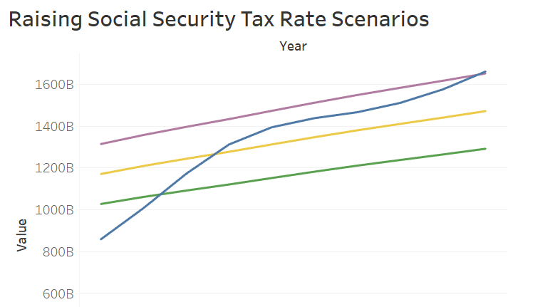
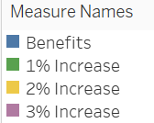
Identical logic used to compute collections and benefits
Collections calculated with a 1% change in employee and employer tax rate (2% collectively)
3% Increase (6% collectively) contains benefits through 2060

Slide 33
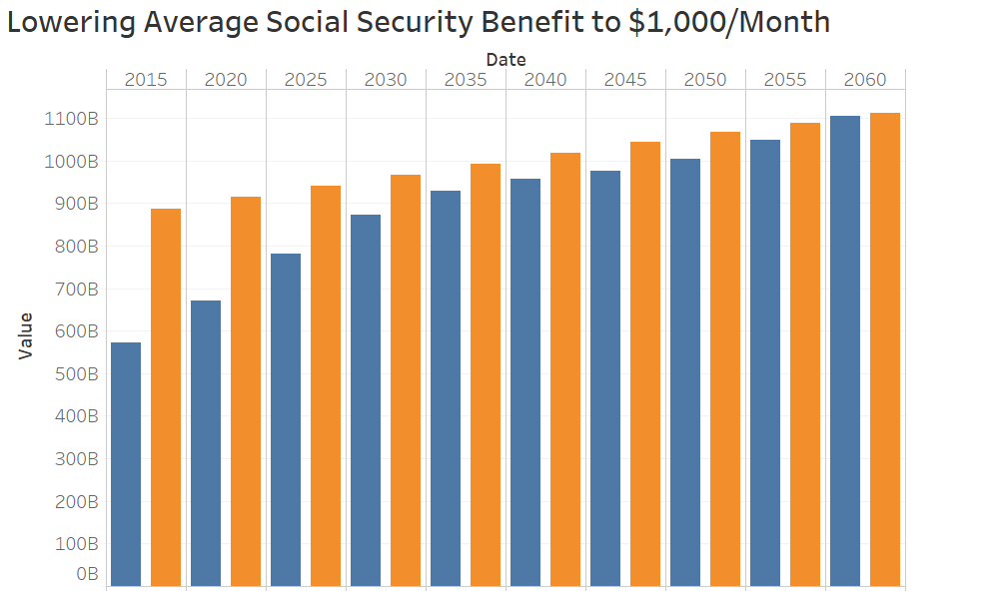
Identical logic used in calculation
Adjusted mean monthly benefit in benefit formula (Population over 65 * $1,000 * 12)
Close to breakeven
collections/benefits through 2060
Concern is elderly quality of life, and lack of ability to save for retirement

Slide 34
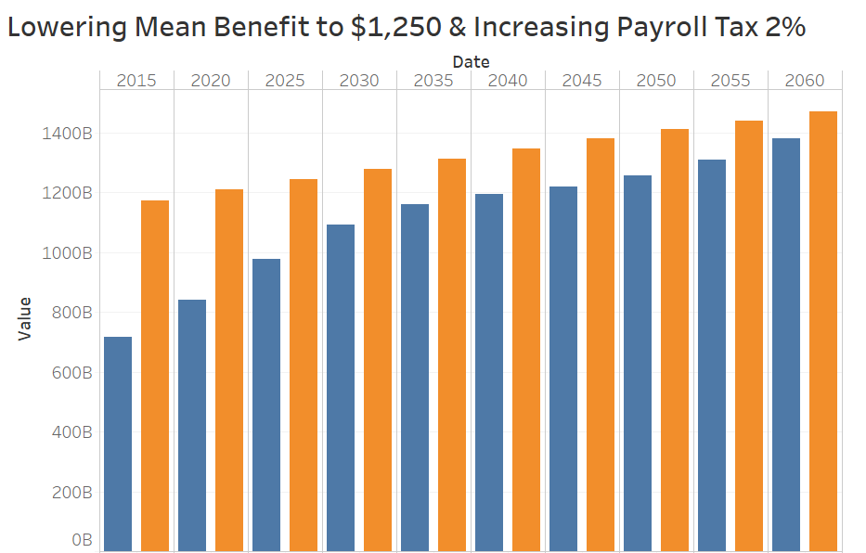
Concern for quality of life in only lowering monthly benefit
Combined adjustment of lowering benefit to $1,250 and raising payroll tax 2% (4% collectively)
Scenario contains benefits until 2060

Slide 35
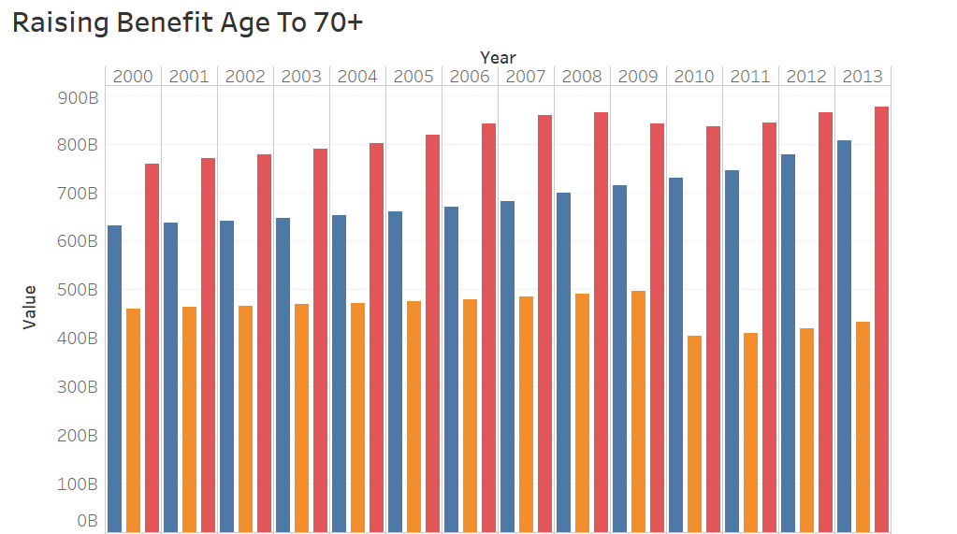
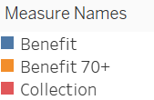
Benefit 70+ = (Population over 70 * 1,503 * 12)
Benefit / Collection = Same as prior
Significant impact from 2010 - 2013
Although we expect future 70 + benefit would still surpass collections around 2030

Slide 36
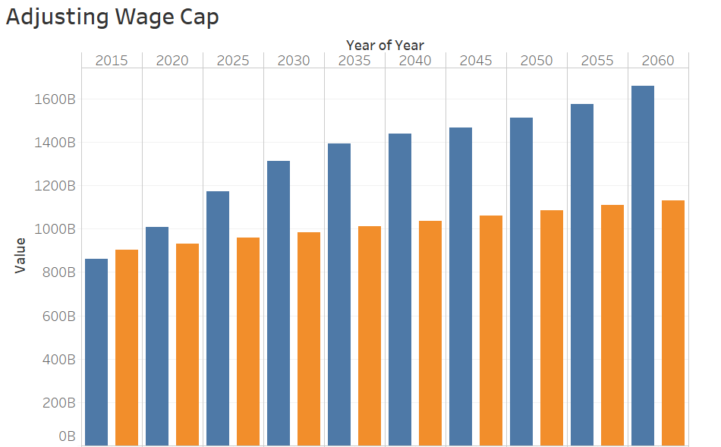
Adjusting Wage Limit to $200,000
Identical logic used in calculation
Adjusted wage limit incrementally until no impact was seen from further adjustment
Optimal level = $200,000
Lessens impact of increasing impacts but will still need more adjustments to breakeven by 2060

Slide 37
Social Security Conclusions
Social security could be in defecit by 2020 and will likely be an important topic in the 2020 election
If not contained the deficit could reach ½ Trillion Dollars per year by 2060
Defecit can be addressed by raising taxes, lowering benefits, raising the wage limit, or raising the benefit age.
Likely some combination of the above options will need to be implemented

Slide 38

Questions?

